Slide 1
START EARNING MORE WITH
AIRBNB IN LOUISVILLE
JONATHAN KLUNK

Slide 2
01
Who is Jonathan Klunk?
CEO of Louisville Short Term Rentals (formerly Key Source Properties)
Louisville's #1 Short Term Rental Management Company
$3+ million in Revenue - 2019
Realtor & Founding Partner
Six Degrees Real Estate
Notes:
7-year Airbnb veteran
CEO of Key Source Properties
Louisville Realtor
Partner at Six Degrees Real Estate

Slide 3
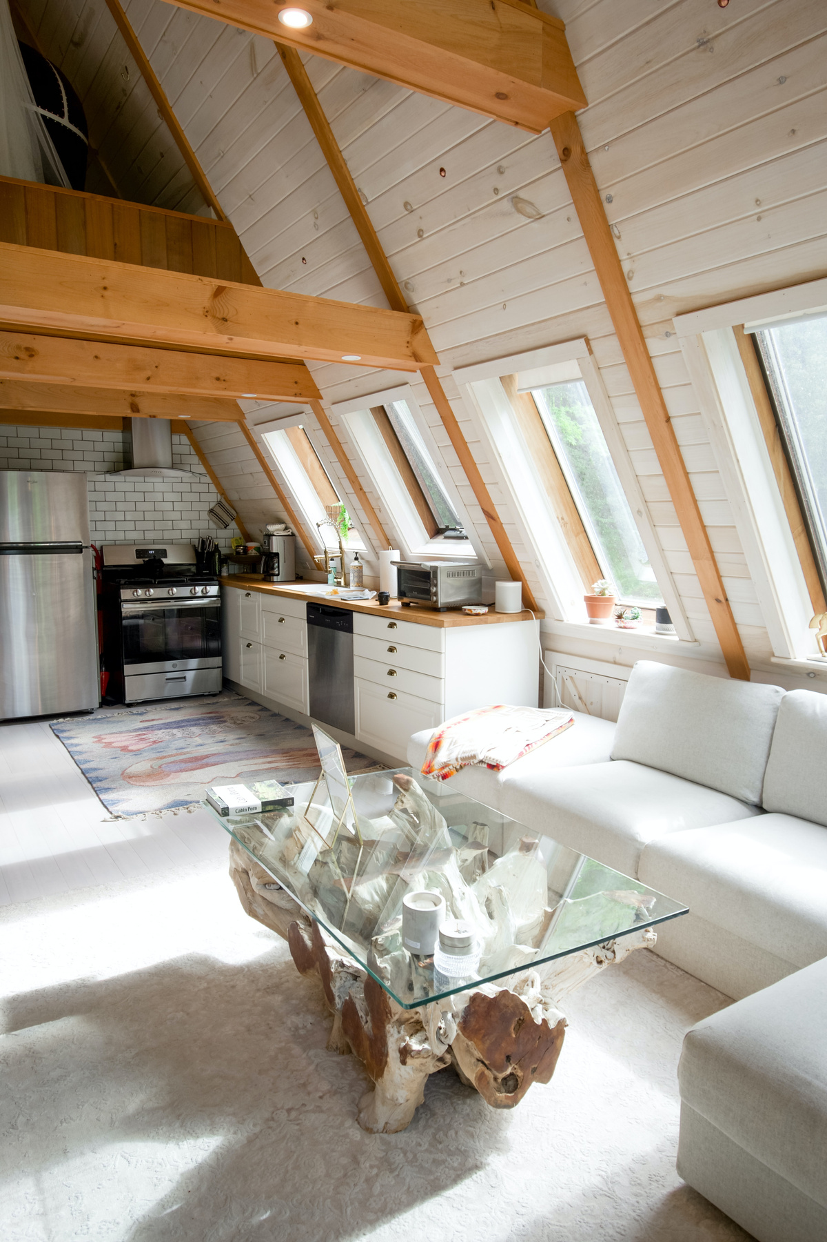
MARKET STATUS
Why is Airbnb so hot?
Short term rentals are the future of travel.
People can work from anywhere.
Furnished accommodations are growing in popularity and use case.
02

Slide 4
03
Where is the industry going?
Thankfully, upward! The lingering effects from the pandemic suggest that guests will continue to opt for a more secluded accommodation option, rather than shared communal spaces such as hotels.
For homeowners, the flexibility of Airbnb ownership means they are able to appeal to both short term renters (such as weekend getaways) and longer stays (such as monthly work trips).

Slide 5
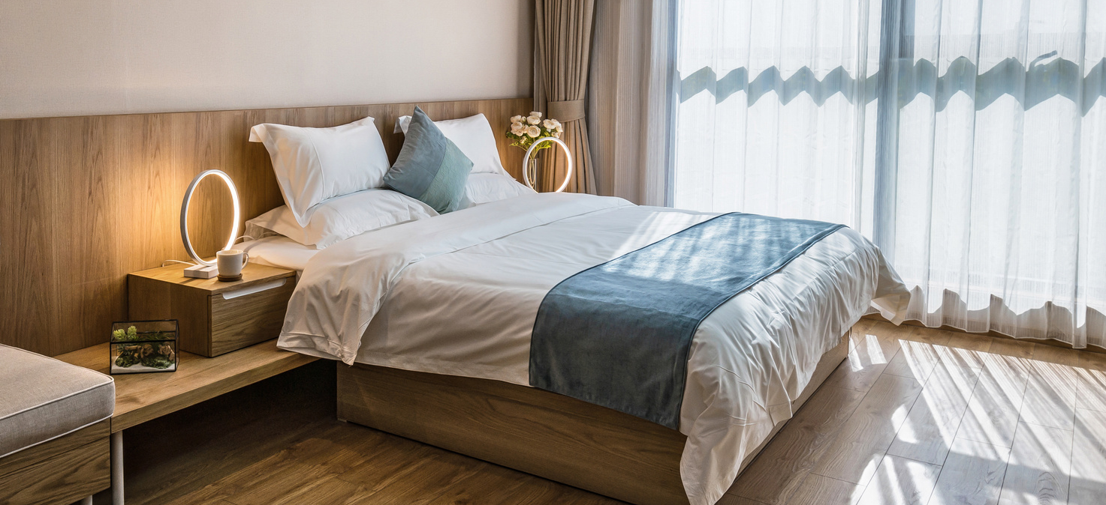
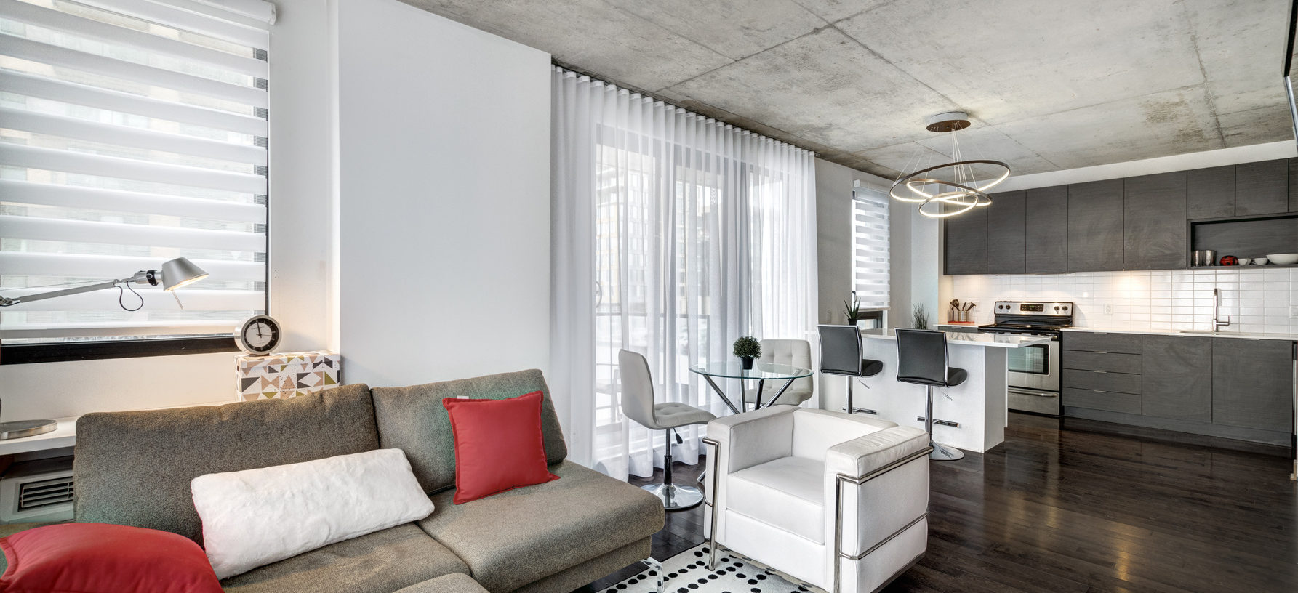
04
What is a Short Term Rental?
Short-term rentals, also called vacation rentals, are typically furnished apartments, condos, or houses where renters can feel more at home. Short-term rentals can be more appealing than hotels because of the prices, furnishings, and amount of space they can often provide.
Notes:
Short term rentals are defined by the City of Louisville as a contract on a property for 29 days or less.

Slide 6
Find a property
Get licensed or registered
How to start an Airbnb in Louisville?
Furnish the property
List it on STR sites
05

Slide 7
06
Single Family Residence
STRs are allowed in residentially-zoned SFRs. They will require a permit if the property is not your primary residence. Commercially-zoned SFRs only require annual registration.
Louisville Short Term Rental Zoning.
Duplex & Multi-Family
A residentially-zoned duplex will require a permit, even if it is owner-occupied (2 dwelling units). STRs are not allowed in any capacity in residential multifamily properties (3+ units). Commercial zoned properties only require annual registration.
Commercial Zoning
STRs are allowed by right in almost all commercial zoning. Annual registration is required.

Slide 8
07
Make an Impact
Start a Pinterest board to collect ideas. Look for inspiration for other listings - local and outside. Consider naming your property and using a theme.
Furnishing your
property.
Do it Yourself
Set a budget and stick to it. Invest in quality furniture where it counts (sofas and beds). Use local and online resources to furnish.
Hire a Designer
Interior designers can add value by charging an hourly fee to make selections for your property. Use your resources to find a local person who may be a good fit or use an online option.

Slide 9
08
Hosting
Do you have what it takes?
The community is powered by hosts, who provide their guests with the unique opportunity to live like a local while traveling. Hosting is going to require you to wear quite a few hats, though.

Slide 10
What does a host do?
Adjust calendar rates
Guest communication
Cleaning and linens
Provide
inventory
Emergency
response
09

Slide 11
10
How to become a Superhost.
No Cancellations
90+% Response Rate
Making zero cancellations – except under Airbnb's extenuating circumstances. This can be done by ensuring your booking calendar is always up to date.
Superhosts must reply to at least 90% of messages received within 24 hours. One simple way to achieve this is by having the Airbnb app on your phone.
Overall Rating of 4.8+
Host at Least 10 Guests Each Year
Keeping a property rating of 4.8/5 may seem a feat, but it can be achieved through accuracy, communication, location and other key factors.
Ensuring your listings are presented in the best light with high quality photography is a sure way to hit this goal. Seasonal pricing will also be key.

Slide 12
11
Short Term Rental Management.
For a percentage of the gross revenue, you can reap the rewards of a short term rental property without dealing with the responsibility of booking, inventory, cleaning, and more. Louisville offers a number of STR Management options.

Slide 13
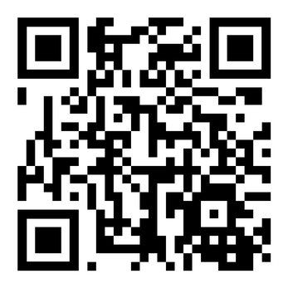
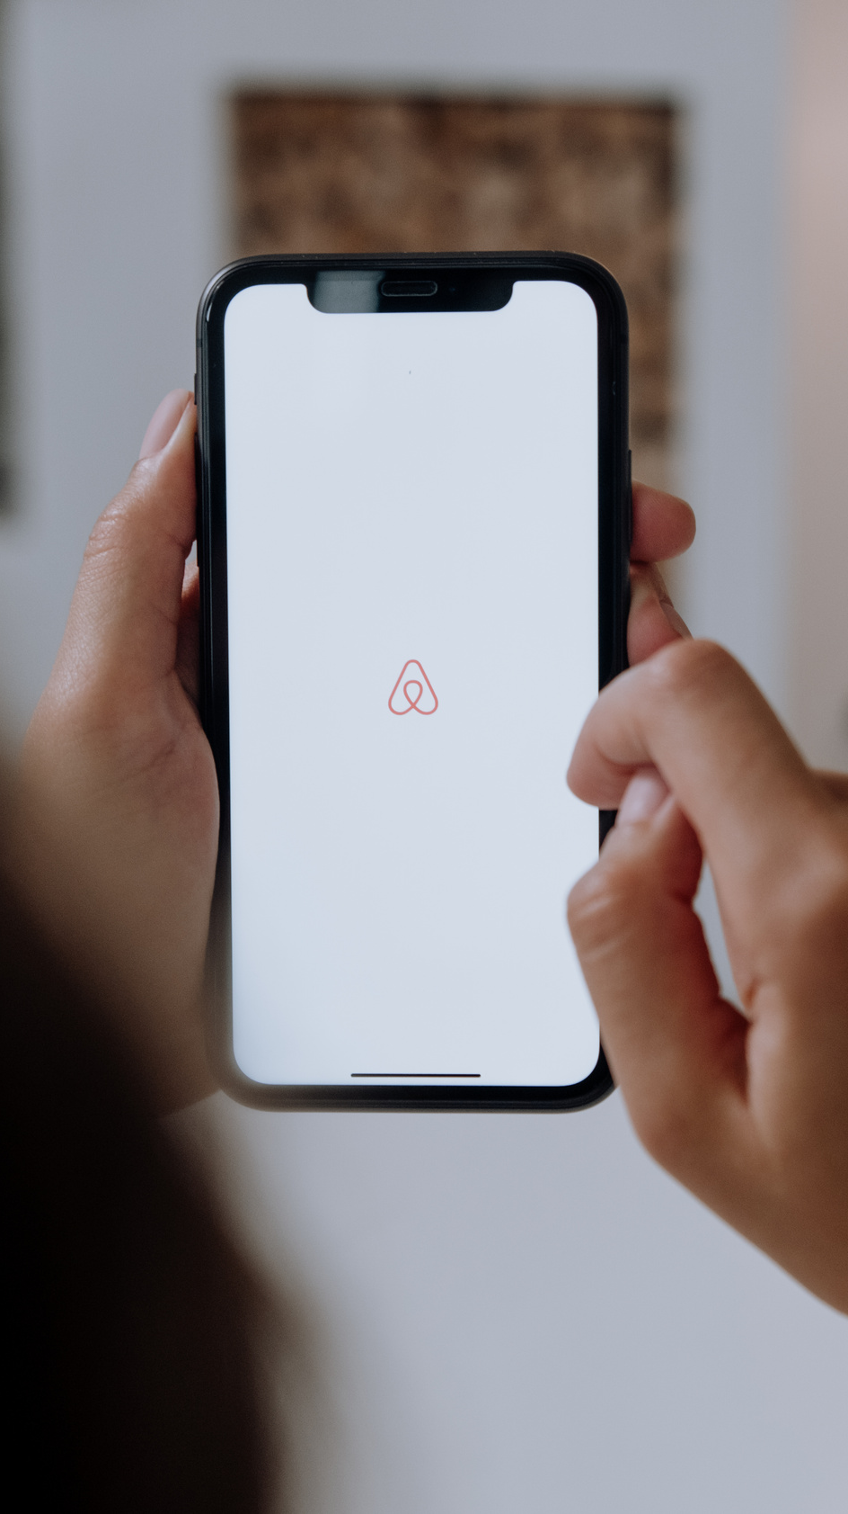
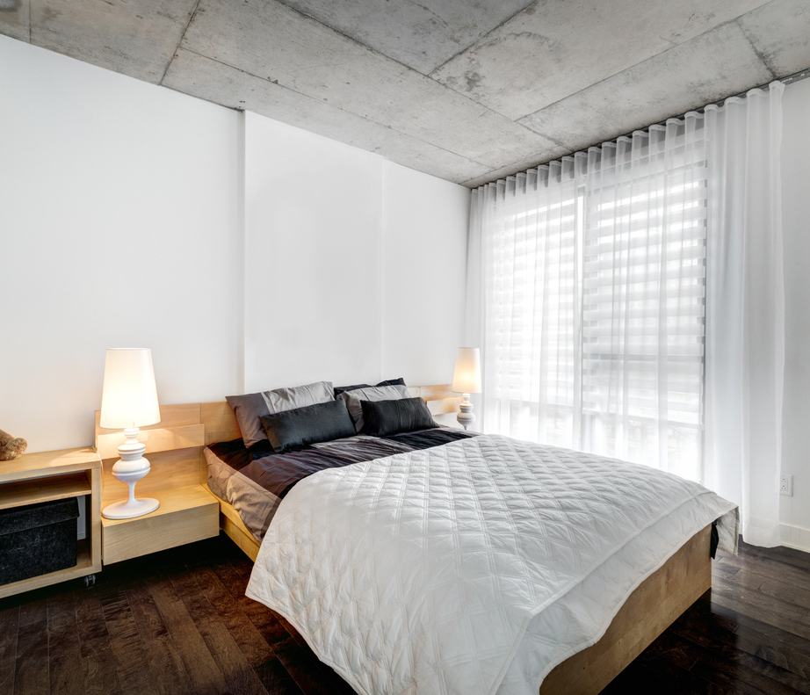
12
A gift from me to you.
Visit gokeysource.com/airbnb
For your FREE Zoning Guide & Airbnb Setup Checklist.
Notes:
Let's add the list of everything needed to stock a short term rental as a giveaway so we can give 2 things.
Let's add a QR code to the page so people can scan the screen with their phones.

